Slide 1
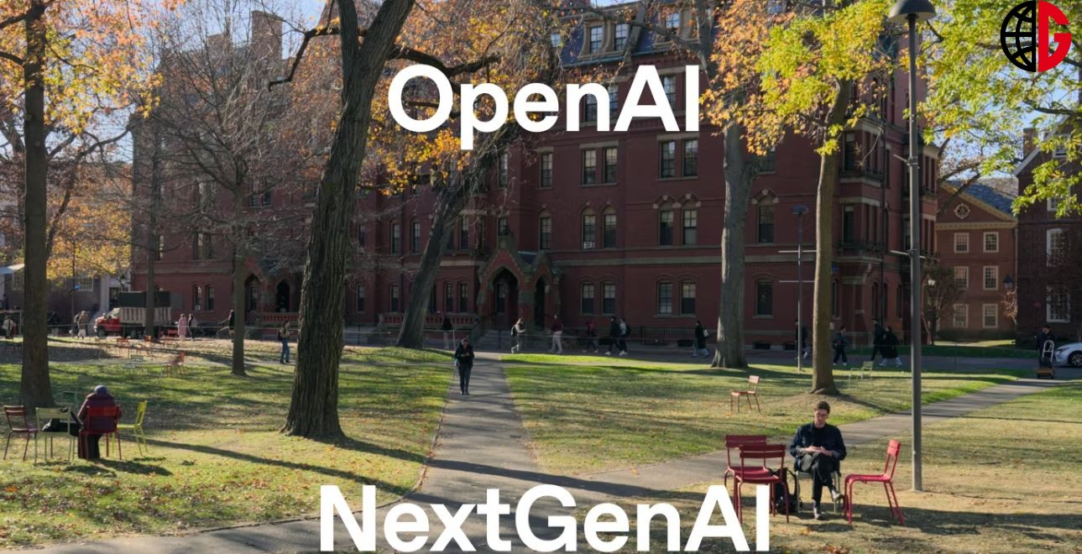
NextGenAI International Organization
Empowering Young Thinkers for an AI-Powered Tomorrow
A student-led, mentor-supported organization dedicated to equipping high school students with foundational AI knowledge, encouraging them to design AI-driven solutions for global challenges, and facilitating collaboration among AI clubs worldwide.

Slide 2



Our Mission
Empower Young Thinkers
Shape AI-Powered Tomorrow
Education, Innovation, Collaboration
Dedicate the organization to empowering young thinkers worldwide
Help young people shape an AI-powered future through the organization's efforts
Achieve the mission through education, innovation, and global collaboration
NextGenAI is dedicated to empowering the next generation of young leaders to thrive in an AI-driven world through a multifaceted approach of education, innovation, and global collaboration.

Slide 3
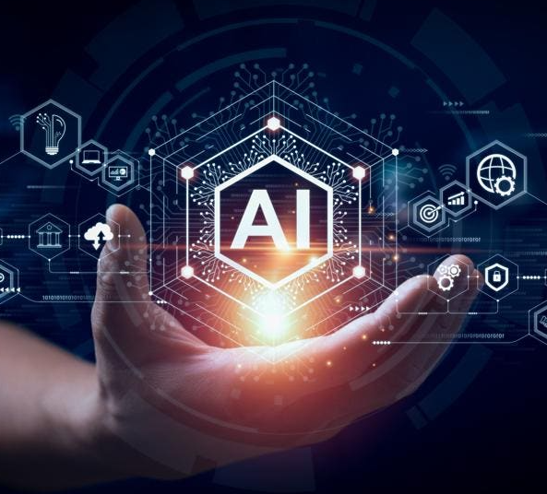
Why Now?
The AI revolution is transforming industries like healthcare, education, and sustainability. Young people must be equipped to lead ethically in this AI-driven future. NextGenAI aims to engage the next generation early and bridge gaps in AI education and access worldwide.

Slide 4
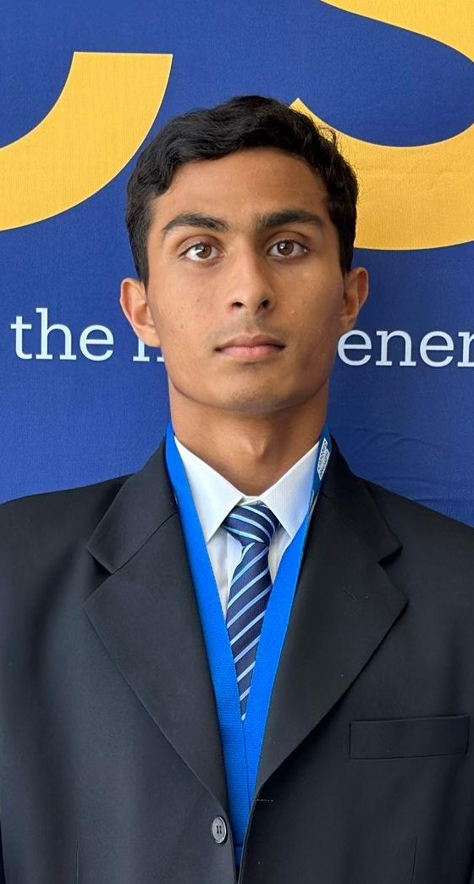
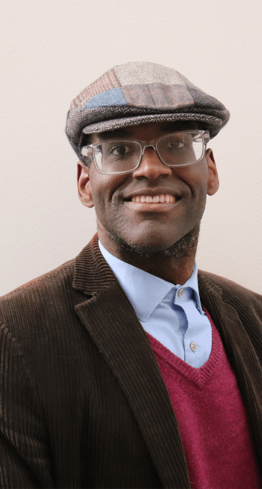

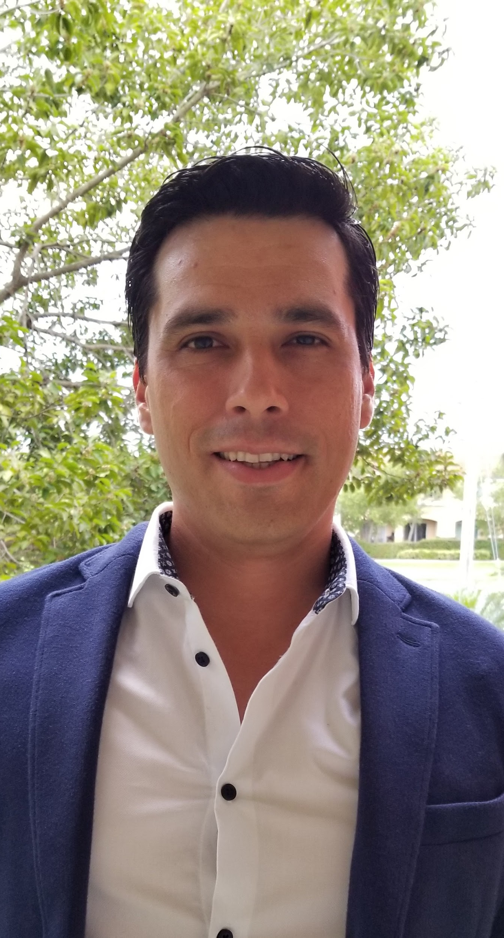
Organizational Structure
Aaryan Samanta
Mr. Marvin
Mrs Laurence
Mr. Carlos
President & Founder (Chief, Global AI Ambassador)
Mentor
Mentor
Mentor

Slide 5





Our Activities
Innovations & Internship
AI Exploration & Learning
Global Collaboration & Outreach

Slide 6
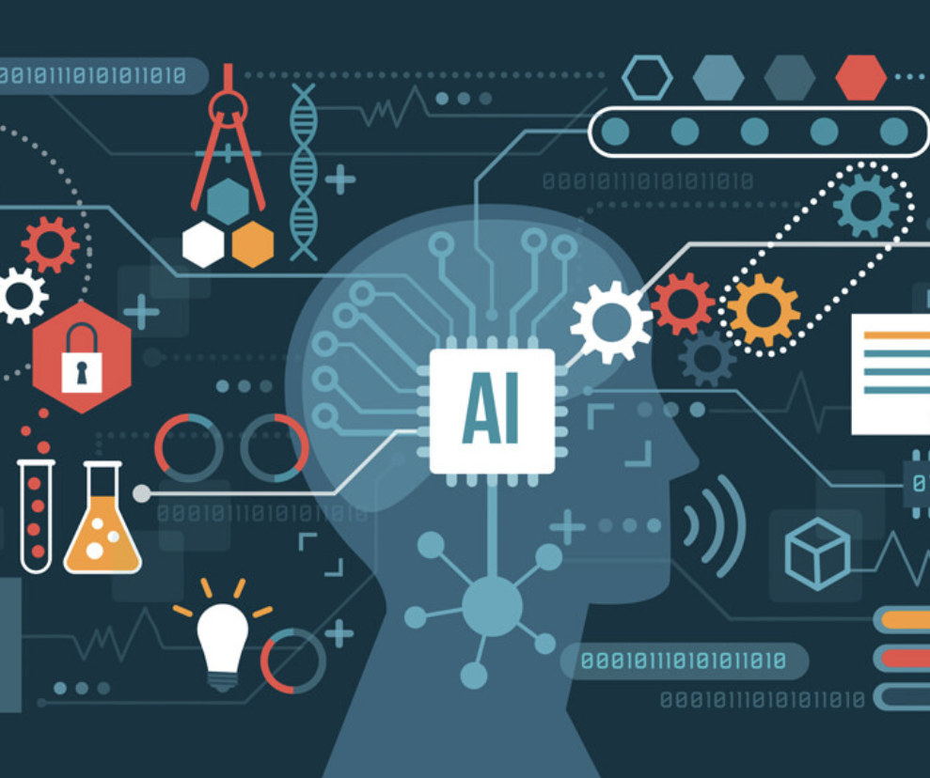
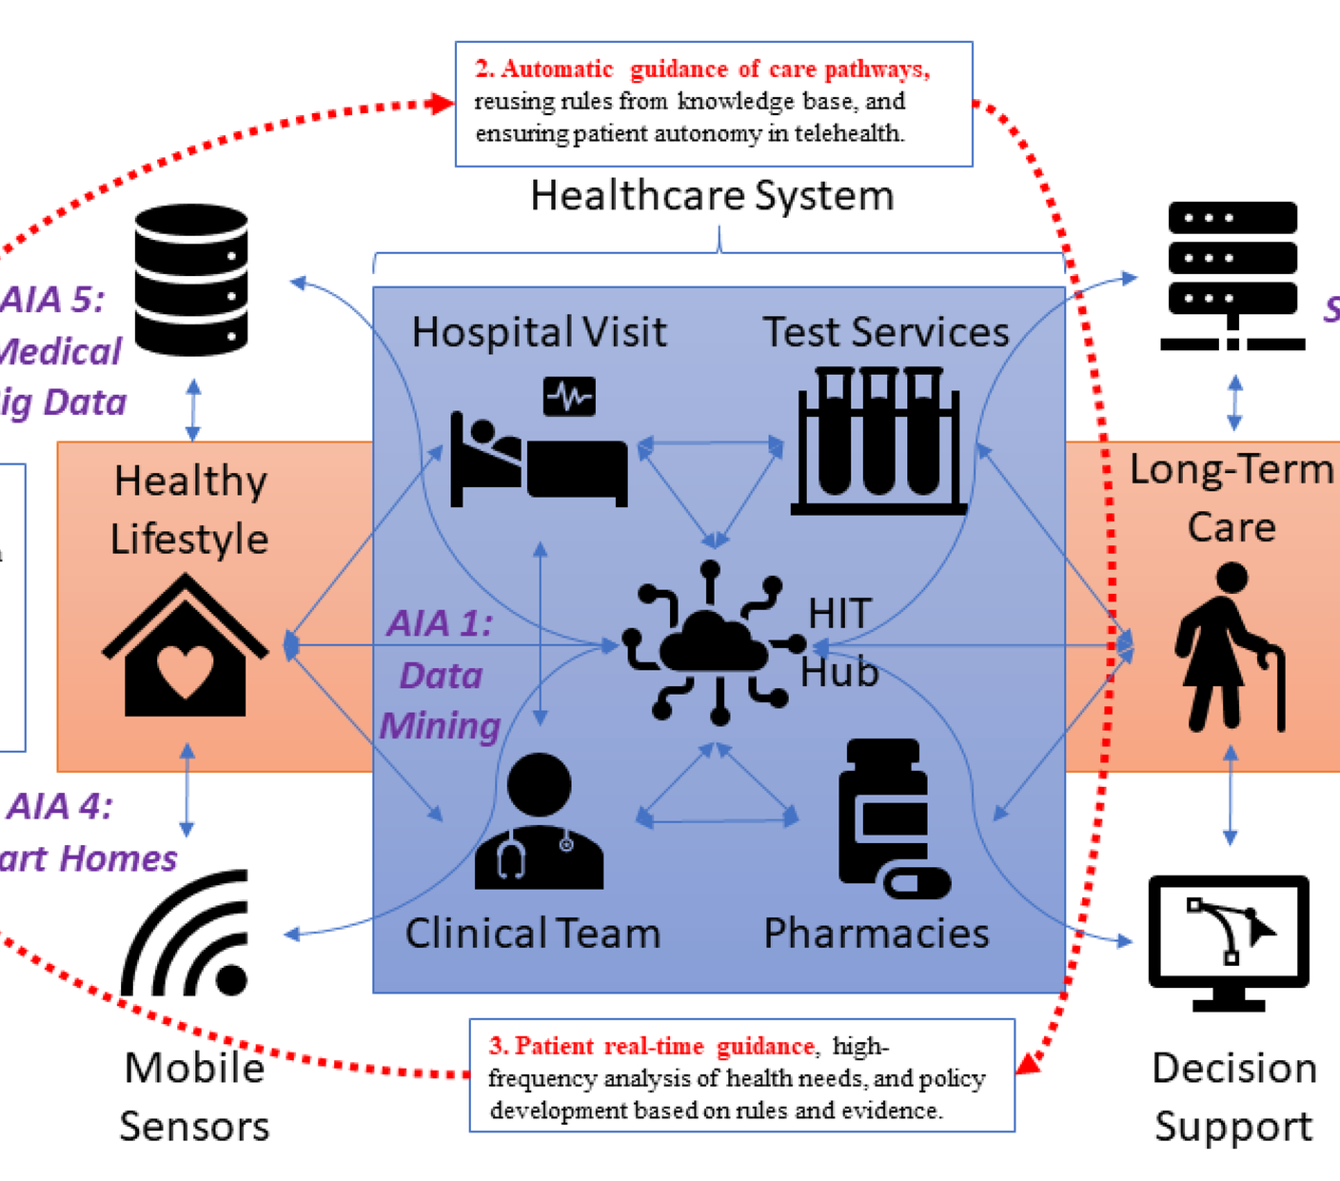
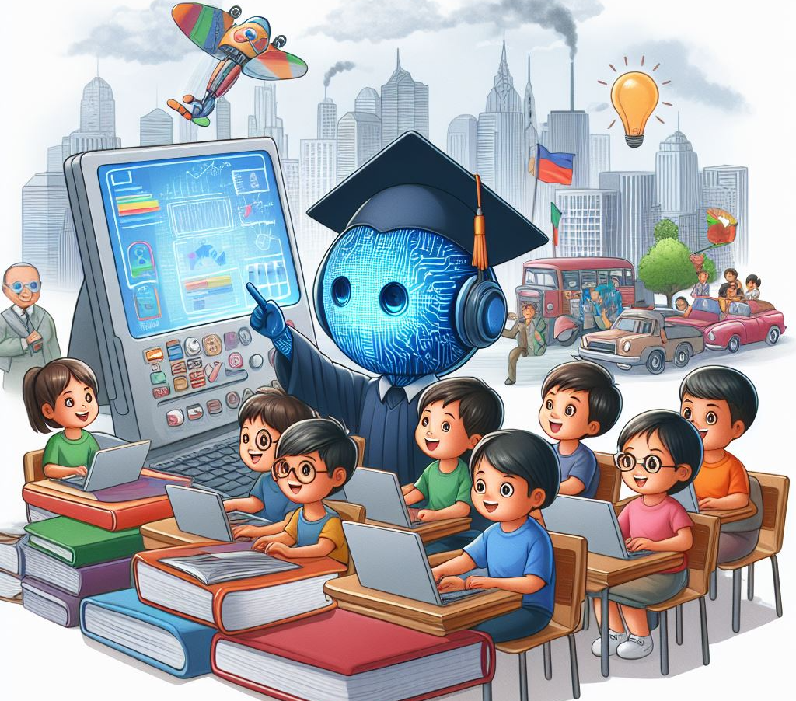
Innovations & Internship
AI Internships
Design a Future-AI Tool
Showcase Days
Students research topics like bias in algorithms, emotion recognition, or AI in medical imaging.
Students propose AI-based apps or systems to address real-world issues like healthcare, education, and sustainability.
Students present their AI projects to school communities and local organizations.

Slide 7



AI Exploration & Learning
AI Ethical Awareness
Guest Speaker Series
AI Workshops
Conduct a school survey to assess AI ethical awareness, propose an AI ethics curriculum, and develop a validated measurement instrument using the Berkeley Assessment System (BAS) framework.
Organize quarterly talks by AI experts from academia, industry, or startups to expose students to diverse perspectives on AI.
Host workshops covering AI fundamentals, coding, and ethics to provide hands-on learning opportunities for students.

Slide 8




Global Collaboration & Outreach
Community Workshops
Host sessions to teach AI basics to younger students or parents
Student-Led Media
Outreach & Impact
Publish an AI blog or podcast featuring student insights and interviews
Measure program growth, project completions, and community engagement
Global Partnerships
Collaborate with schools, universities, NGOs, and industry to advance AI education
Virtual Meetups
Cultural Exchange
Connect AI clubs across schools for challenges and cultural exchange
Foster cross-cultural connections and shared learning among AI clubs worldwide

Slide 9



Key Themes
Ethical AI & Bias Mitigation
AI for Social Good
Cross-Cultural AI Innovation
Ensure AI systems are designed and deployed with strong ethical principles to mitigate biases and promote fairness.
Leverage AI to address real-world challenges in healthcare, education, sustainability, and other domains that positively impact society.
Foster a global community of young thinkers who collaborate across borders to develop innovative AI-powered solutions.
NextGenAI is dedicated to empowering the next generation of AI leaders who will shape a better, more equitable future through ethical, socially-conscious, and globally-connected innovation.

Slide 10




AI Ethical Awareness
Construct Map
Question Design
Scoring Guide
Rasch Modeling
Create a construct map that defines low, medium, and high levels of AI ethical awareness. This blueprint will represent the qualitative aspects of the variable of interest.
Construct survey questions that can measure the varying levels of AI ethical awareness, from low to high, based on the construct map.
Develop a scoring guide that relates different response scores back to the levels defined in the construct map.
Apply Rasch modeling to test the hypothesis that the AI ethical awareness variable behaves in the way that was hypothesized in the construct map and survey questions.

Slide 11
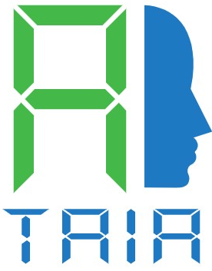
Collaboration Strategy
High Schools/Universities
Non-Profits
Partner with schools to establish AI clubs and integrate AI education. Reach out to university AI labs for mentorship and resources.
Collaborate with organizations focused on education or technology access (eg. AI Ethos) for funding and outreach.
Industry
Open Learning Network (OLN)
Engage with AI associates (eg. TAIA) & companies for guest speakers and internship opportunities.
Open Learning Networks (OLNs) are a transformative educational model combines institutional coursework with community involvement, global experiences, interdisciplinary content, making learning truly borderless.

Slide 12

Join Us!
Shape the future of AI
Gain access to innovative student projects
Be part of a global movement for ethical AI education
Partner with NextGenAI to empower young leaders and shape the direction of AI development.
Collaborate with NextGenAI to get early exposure to cutting-edge AI solutions developed by talented students.
Join NextGenAI's mission to promote responsible AI practices and build a more inclusive, sustainable AI ecosystem worldwide.
Together, let's empower the next generation to create an AI-powered tomorrow that benefits all.

Slide 13
“We're building a movement—powered by youth, grounded in purpose, and connected by learning.”
PAUL CHAN, PRINCIPAL, LEGEND COLLEGE PREPARATORY

Slide 14
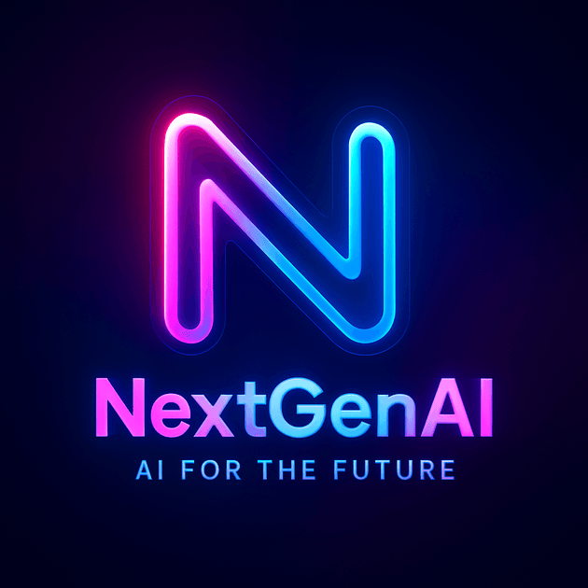
Empowering Young Thinkers for an AI-Powered Tomorrow
NextGenAI International Organization is a student-led, mentor-supported organization dedicated to empowering young thinkers worldwide to shape an AI-powered tomorrow. The organization aims to foster ethical AI awareness, develop practical AI skills, and inspire solutions to real-world challenges.

